Slide 1
Fuzzy Logic Basics
January 2019

Slide 2
Fuzzy Logic
Fuzzy set theory was first introduced in 1965 by Lotfi A. Zadeh [Zadeh 1965]. It may be regarded both as a generalization of classical set theory and as a generalization of dual logic. Let us first examine the basic aspects of set theory, after which we will go on to consider its logical interpretation.

Slide 3
Fuzzy Logic
A classical set can be regarded as a grouping together of elements, all of which have at least one common characteristic. If an element possesses this characteristic, it belongs to the set. If an element does not possess this characteristic, it does not belong to the set. In fuzzy set theory, the set is no longer restricted to this binary (yes/no) definition of set membership, but rather allows a graduated definition of membership.

Slide 4
Fuzzy Logic
This means that a degree of membership to a set can be specified for each element. This set is then referred to as a fuzzy set. Below, classical sets are indicated by capital letters, while fuzzy sets are identified by capital letters bearing a tilde (~).

Slide 5
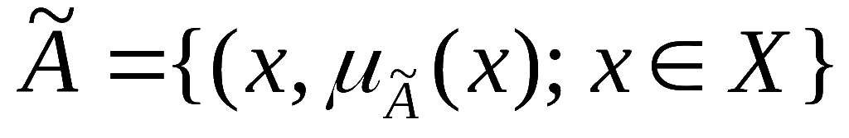

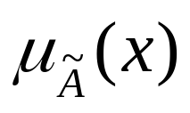
Fuzzy Sets
Definition
For X a crisp (classical) set of objects which is to be analyzed by fuzzy means, then
represents a fuzzy set of X, where represents the membership function and represents the degree of membership of element x to the fuzzy set .

Slide 6
Fuzzy Sets
Example
The temperature T for the optimum operation of a cooling process in an industrial plant is set by the plant's manufacturer at -136 °C. However, experience acquired in the course of operation of the plant has shown that this value fluctuates both positively and negatively. When questioned on this matter, the plant operator reports that the plant can be operated without any problems between -140 °C and -132 °C. A model of this observation produced with the aid of the fuzzy set theory is shown below.

Slide 7
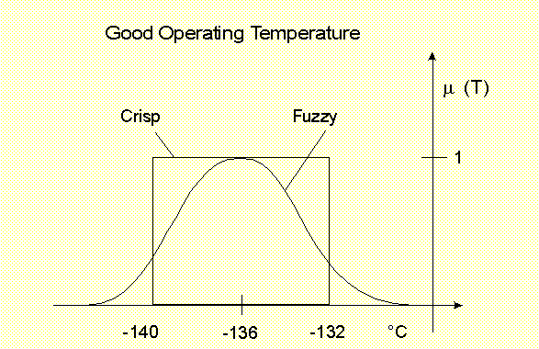
Fuzzy Sets

Slide 8
Fuzzy Sets
The figure above clearly illustrates the advantages of a modeling process employing fuzzy sets. Assuming that the monitoring operations are automated, with the crisp set the plant operator would not obtain any information on the status of the plant when the temperature was in the crisp interval between -140 °C and -132 °C. This means that he obtains the same evaluation at -139.9 °C as at -136 °C, and is surprised when the system suddenly indicates an error message (i.e. when the temperature falls below -140 °C).

Slide 9
Fuzzy Sets
In the case of the fuzzy model however, the membership values enable him to observe both the status of the plant and its trend over time. This mode of assessing the situation is also substantially more realistic.

Slide 10
Fuzzy Sets
The use of a process subject to uncertainties using membership functions in the manner employed in the above figure is frequently confused with the density functions or the distribution functions of probability theory. A membership function has a totally different interpretation.

Slide 11
Fuzzy Sets
It states the degree of membership of an operational status to the set of "good operational statuses". If the function is interpreted as a density function, the probability that the temperature is below -136 °C will be 0.5, assuming that the presented function is symmetrical. However, probability theory does not provide any information as to the extent to which the temperature is one of "good operational status". This should suffice to differentiate the fuzzy set theory from the probability theory.

Slide 12
Fuzzy Sets
A large number of different types of fuzzy sets have since been proposed in the relevant literature. For our purposes here, we will consider two of these types which have acquired special importance for applications: so-called fuzzy numbers and linguistic variables; see also Zimmermann [Zimmermann 1996].

Slide 13
Fuzzy Numbers
Definition
A fuzzy number is a convex, fuzzy set, normalized over the interval [0,1] of the set of real numbers. Precisely one element with a degree of membership 1 exists. The membership function of this fuzzy set is piecewise continuous.

Slide 14
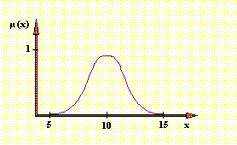
Fuzzy Numbers
Example
The following figure shows the example of a fuzzy number "approximately 10."

Slide 15
Linguistic Variables
Definition
A linguistic variable is a variable whose values are not numbers (as in the case of a deterministic variable), but rather linguistic constructs (so-called terms). The contents of these terms are defined by fuzzy sets over a base variable.

Slide 16
Linguistic Variables
Example
The condition 'operating temperature', as a linguistic variable, could assume the values (terms) 'too low', 'good' and 'too high'. The contents of each of these terms could then be defined as a fuzzy set over the scale of temperature T in °C (base variable).

Slide 17
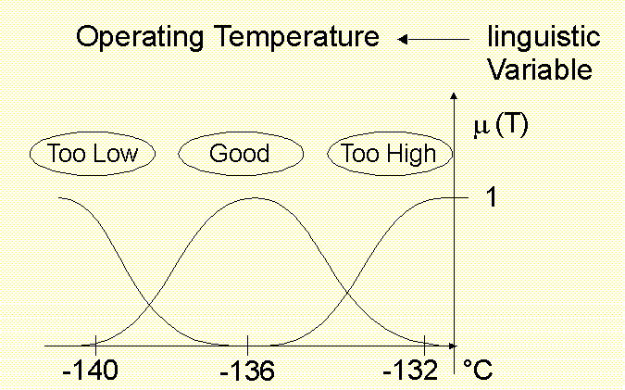
Linguistic Variables

Slide 18
Linguistic Variables
The concept of the linguistic variable illustrates clearly how fuzzy sets can form the bridge between linguistic expressions and numerical information. In the above example, the set of terms represent the real manner in which a plant operator would describe the operating temperature of a cooling process. The base variable, on the other hand, represents a physical scale which can be specified to any desired level of accuracy.

Slide 19
Operating with Fuzzy Sets
In order to describe a set theory, in addition to its elements (the sets), it is also necessary to define the operations which can be applied to join or transform the sets. In fuzzy set theory, these operations are defined via the respective membership functions, the most important components of the fuzzy sets. The operations proposed by Zadeh in 1965 are specified below. Numerous expansions and modifications to these statements have since been developed; see Zimmermann [Zimmermann 1996] for example.

Slide 20


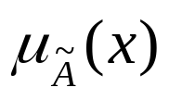
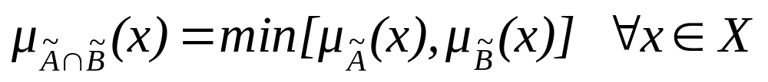
Operating with Fuzzy Sets
Definition
The membership function of the intersection of two fuzzy sets and with the membership functions and
is defined point-wise by:

Slide 21
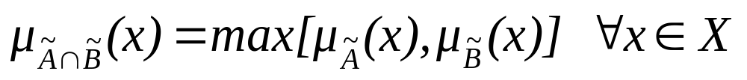
Operating with Fuzzy Sets
Definition
The membership function of the union of two fuzzy sets
and with the membership functions and
is defined point-wise by:

Slide 22
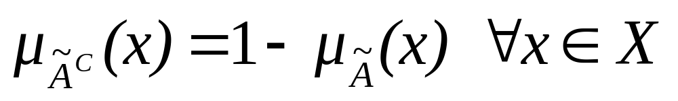
Operating with Fuzzy Sets
Definition
The membership function of the complement of the normalized fuzzy set is defined by:

Slide 23
Operating with Fuzzy Sets
Example
A production manager is required to decide which customer order is to be put into production next. "high contribution margin" and "short throughput times" are stipulated as corporate objectives. Let us assume that the fuzzy set
"high contribution margin" and the fuzzy set
"short throughput times" are defined as follows:
= {(15,1),(10,0.8),(5,0.4),(2,0.2),(0,0)}
= {(1,1),(2,0.6),(3,0.4),(4,0.2),(5,0.1),(6,0.05)(7,0)}

Slide 24
Operating with Fuzzy Sets
The base variables of these fuzzy sets are contribution margin and throughput time respectively.
Order 1 Order 2
Contribution margin (Thousand $) 10 2
Throughput time (Days) 5 4

Slide 25
Operating with Fuzzy Sets
On the basis of the definition of the membership values and the known attributes (order characteristics) of the two orders shown in the table above, order 1 has a membership of 0.1 and order 2 a membership of 0.2 of the fuzzy set "high contribution margin and short throughput time".
It is assumed here that the mean is determined as the minimum of the individual values. On the basis of this result, the person responsible for making the decision would first of all put order 2 into production.

Slide 26
Operating with Fuzzy Sets
This contradicts the human decision-making process, however, since the contribution margin of order 1 possesses a very high degree of membership in comparison to order 2.
As a result of the use of the minimum operator this factor is not incorporated in the solution to the problem.

Slide 27
Compensatory operators
This can be avoided by using compensatory operators to model the "linguistic and". Below, the operators M_{W1} for the "fuzzy and" and M_{W2} for the "fuzzy or" are presented as examples of averaging operators in accordance with Werners [Werners 1984], together with the γ-operator K_{Z} [Zimmermann, Zysno 1980] as examples of compensatory operators.

Slide 28
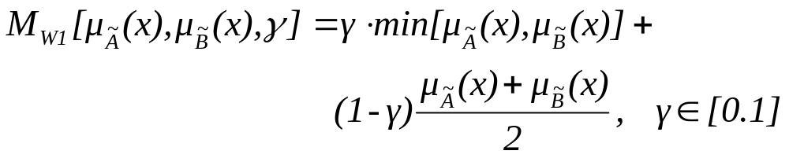
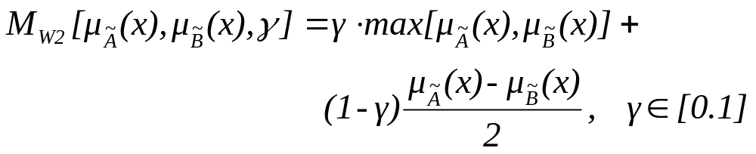
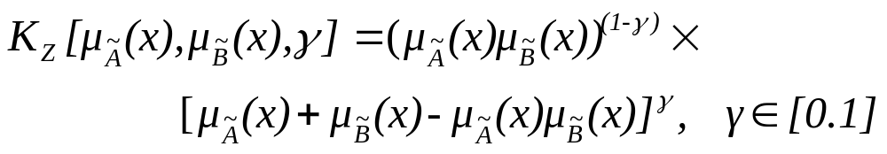
Compensatory operators

Slide 29
Continuous Attributes
While the previous example permitted statements on the processing of discrete fuzzy sets, the following shows a corresponding procedure for problems involving continuous attributes.
Example
A unit of a complex chemical plant is to be maintained in the "best possible operating state". We will assume that this state is characterized by the two variables temperature and pressure. Let us further assume that a good operating state applies when the temperature is high and the pressure is low, the interactions being ignored.

Slide 30
Continuous Attributes
Let T=[130,200] be the interval of all possible temperatures (°C) and D=[70,120] the interval of all pressure values (bars). This means that the crisp set of all theoretically possible operating states is given by X = T x D.

Slide 31


Continuous Attributes
Let be the membership function which states to which degree each operating state possesses a "high temperature" and be the membership function which states to which degree each operating state possesses a "low pressure level". These functions are shown in the figure below.

Slide 32
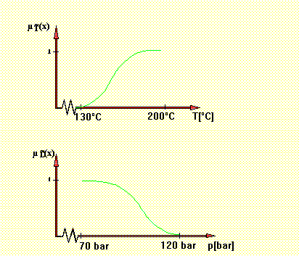
Continuous Attributes

Slide 33
Continuous Attributes
Any operating state can be described by stating its characteristic values (t*,d*) X. The degree to which such a state is classified as "good" can now be determined via the following function:
μ_{good}=min[μ_{T}(t*,d*),μ_{D}(t*,d*)]
The figure below shows this membership function for all possible states.

Slide 34
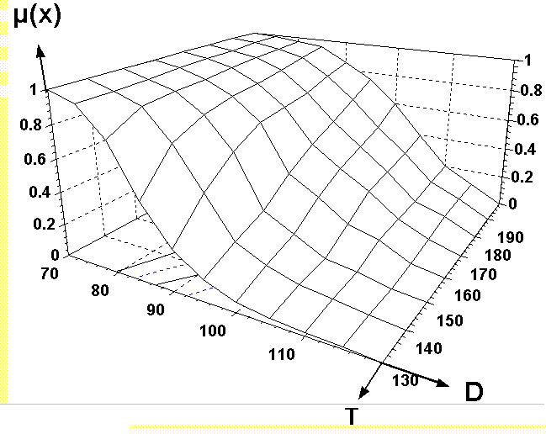
Continuous Attributes

